Slide 1
Microorganisms

Slide 2
What are organisms?
What are microorganisms?
Any living thing.
Includes humans, plants, insects, animals, and microorganisms
A living thing that can only be seen if magnified.
They can be both helpful and harmful.

Slide 3
Protozoan
Harmful
Single-cell animal-like organism
Usually lives in water
Can product their own food

Slide 4
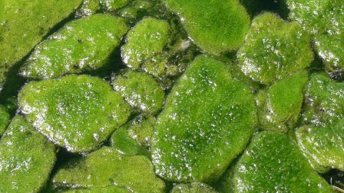
Algae
Helpful
Plant-like protist
Lives in water
Contains chlorophyll
Produce oxygen and their own food

Slide 5
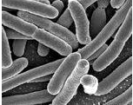
Bacteria
Helpful and harmful
Microscopic single-celled organism
Exist everywhere
Can make their own food
Largest group of microorganisms

Slide 6
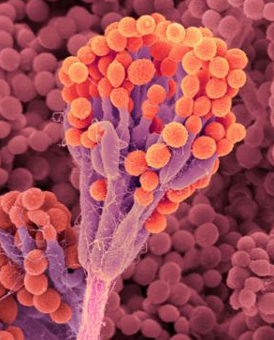
Fungi
Helpful and harmful
Neither plant nor animal
Has characteristics of both
Absorbs food from whatever its growing on

Slide 7
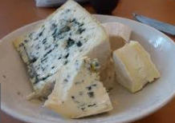
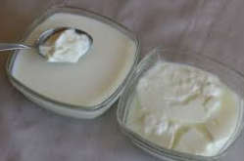
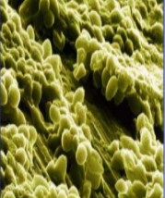
Microorganisms in Food
Mold in cheese
Bacteria turns milk into yogurt
Yeast is a fungus – makes bread rise

Slide 8
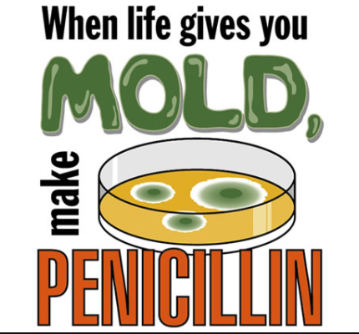
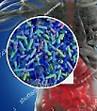
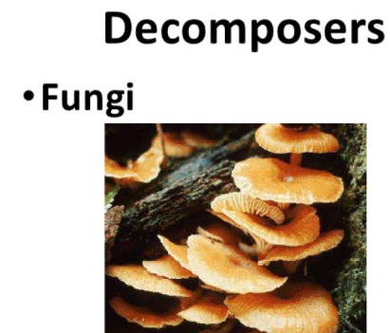
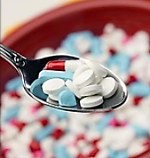
Helpful Uses of Microorganisms
Foods we eat
Medicine
Digestion
Decomposition

Slide 9
Harmful Microorganisms
Salmonella and E. coli: They grow on raw chicken and other meats, raw eggs, and other raw foods.
Algae: Some algae in a red tide contain a poison that can kill fish.
Fungi:
Ringworm spreads easily and grows best on warm, moist skin.
Harmful fungi can rot wood, spoil food, and cause some skin diseases like athlete’s foot.

